Slide 1



Coding of control stream using general ADVANs
Organized by
Taegon Hong, MD, PhD
Clinical Assistant Professor
Clinical Trials Center
Severance Hospital, Yonsei University Health System

Slide 2
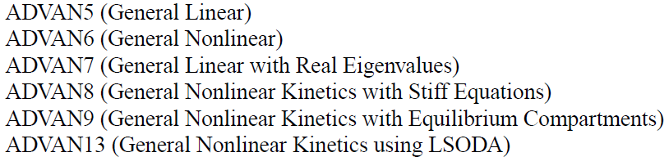
General ADVANs
User-defined model
User-supplied subroutine
Up to 999 compartments using special option of the $MODEL
The $PK block precedes the $DES block
For a nonlinear model: ADVAN 6, 8, 9, 13
NOT used: ADVAN 5, 7

Slide 3
General linear ADVANs

Slide 4
Structure of control file for general linear ADVANs
NAME a project
$PROBLEM ($PROB)
Provide
WHAT TO WORK with
$DATA
$INPUT
Give a
MODEL to fit
$SUBROUTINE - $MODEL - $PK - $ERROR
Suggest
STARTING POINTS
$THETA - $OMEGA - $SIGMA
Indicate
HOW TO WORK
$ESTIMATION ($EST)
$SIMULATION ($SIM)
Ask the form of
OUTCOME
$COVARIANCE
$TABLE

Slide 5
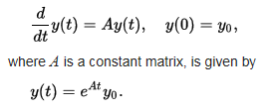

Linear model (ADVAN5 and ADVAN7)
Sufficient to specify compartmental connection and to compute their rate constant parameters with $PK statements
Make use of numerical approximation to the matrix exponential
Linear ordinary differential equation
Basic PK parameters are the rate constant
The first-order distribution of drug from compartment m to n is Kmn
 | ADVAN 5 | ADVAN7
When used? | Eigenvalues of the rate constant matrix are complex | Eigenvalues of the rate constant matrix are known to be real
Example | PBPK model | Many PK systems
Running time | slower | faster

Slide 6
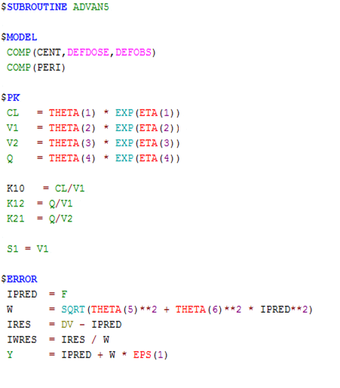

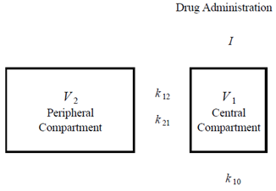
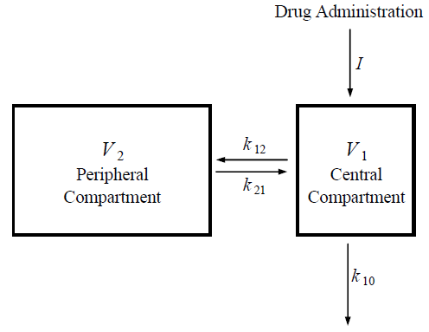
General structure of general linear ADVAN
PREDPP
$SUBROUTINE ADVAN 5, 7
Drug Administration
V₂ Peripheral Comp.
V₁ Central Comp.
Drug Administration
V₂ Peripheral Comp.
V₁ Central Comp.

Slide 7
General non-linear ADVANs

Slide 8
Structure of control file for general non-linear ADVANs
NAME a project
$PROBLEM ($PROB)
Provide
WHAT TO WORK with
$DATA
$INPUT
Give a
MODEL to fit
$SUBROUTINE - $MODEL - $PK - $DES - $ERROR
Suggest
STARTING POINTS
$THETA - $OMEGA - $SIGMA
Indicate
HOW TO WORK
$ESTIMATION ($EST)
$SIMULATION ($SIM)
Ask the form of
OUTCOME
$COVARIANCE
$TABLE

Slide 9
Non-linear model (ADVAN6 and ADVAN8)
Differential equations must be supplied to govern the kinetics, via $DES
ADVAN 6
Linear or non-linear transfer between compartments
the fastest and usually most effective
Runge-Kutta integrator
ADVAN 8
Stiff : big difference in the time constants (long HL : Ka vs Ke)
→ take a very long time to solve using Runge-Kutta methods
(or not be solvable)
Gear integrator designed for solving stiff systems

Slide 10
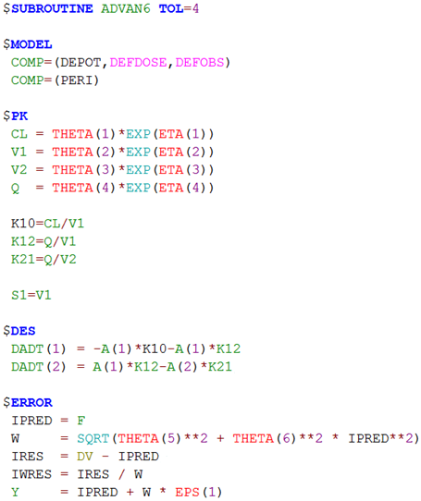
General structure of general non-linear ADVAN
PREDPP
$SUBROUTINE ADVAN 6, 8
Drug Administration
V₂ Peripheral Comp.
V₁ Central Comp.
Drug Administration
V₂ Peripheral Comp.
V₁ Central Comp.

Slide 11
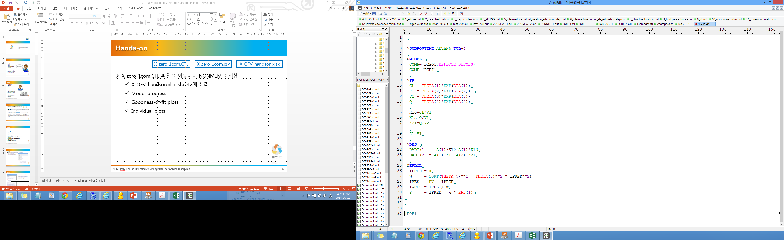
$SUBROUTINES
After definition of CMTs structure and relationships between CMTs
Numerical analysis methodology
$Subroutines ADVAN 6, 8, TOL=n
TOL
To specify tolerance (accuracies) to which compartment amounts are computed by and ADVAN subroutine
sets the number of accurate digits that are required in the computation of the drug amount
SIG in $EST + 1 or 2

Slide 12
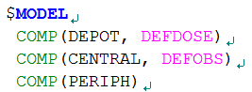
$MODEL Block
Define the number and properties of the compartment of the model
ADVAN 5, 6, 7, 8, 9, 13
Arbitrary name
name of a compartment
Default name: property of the compartment
DEFDOSE: dose events
DEFOBS: observation events
CMT item in data set: appropriate CMT number
EVID item
name
property

Slide 13
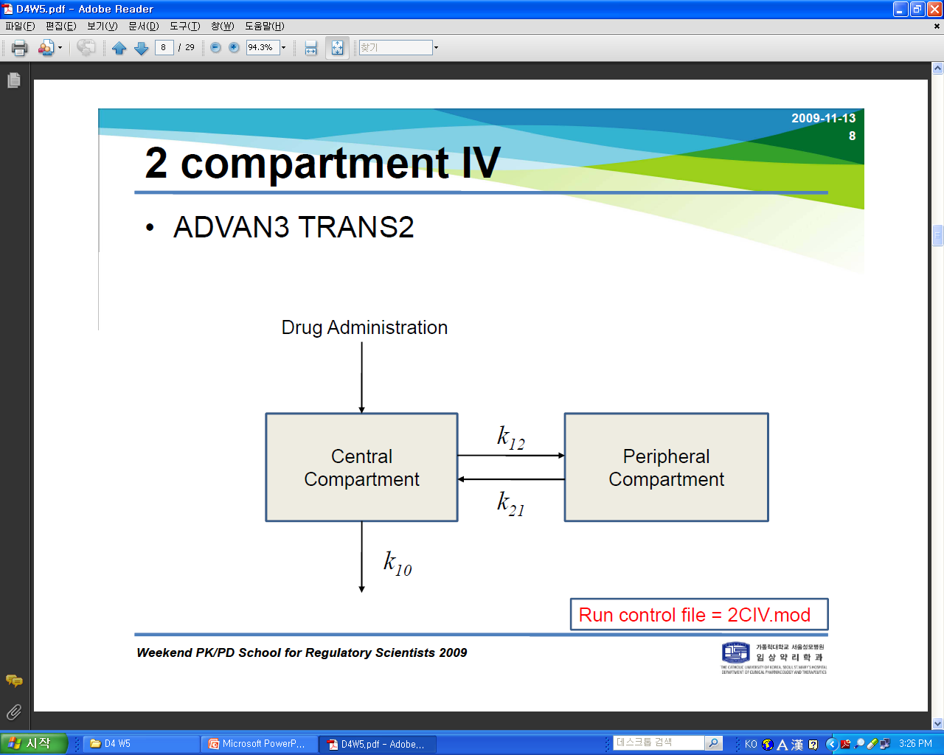
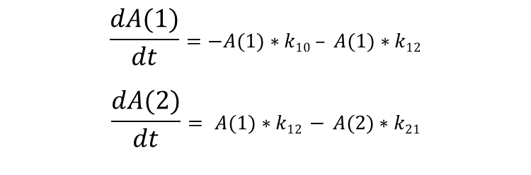
$DES Block
$DES Block coding
DADT(n) – Required for each compartment
Time
Outside the $DES block TIME is a discrete variable, advancing from record to record in the dataset
Within the $DES block – time “T” is continuous and advanced by the numerical differential equations solver
compartment number
$$\frac{dA(1)}{dt}=−A(1)∗k10 – A(1)∗k12$$
$$\frac{dA(2)}{dt}= A(1)∗k12 − A(2)∗k21$$
k12
k21
k10

Slide 14
$DES를 쓰기 위한 control file 구성
$PROB sildenafil 2compartment oral
$DATA ..//sil_2comp.csv IGNORE=#
$INPUT ID TIME AMT DV MDV
$SUBROUTINE ADVAN6 TOL=4
$MODEL
COMP(DEPOT, DEFDOSE)
COMP(CENTRAL, DEFOBS)
COMP(PERIPH)
$PK
……
K20=CL/V2
K23=Q/V2
K32=Q/V3
$DES
DADT(1) = -A(1)*KA
DADT(2) = A(1)*KA -A(2)*(K23+K20) + A(3)*K32
DADT(3) = A(2)*K23-A(3)*K32
CMT
Compartment
the number of accurate digits that are required in the computation of drug amounts
not be too small, too large
SIGDIGIT +1 or 2
DEFDOSE : default dose compartment
DEFOBS : default observation compartment
Differential equations

Slide 15
Quiz.
Q1) DEFDOSE, DEFOBS를 안쓰면 어떻게 될까?
Q2) Dataset에 CMT를 안만들면?
Q3) Dataset에 CMT만들고 DEFDOSE, DEFOBS를 거꾸로 쓰면?

Slide 16
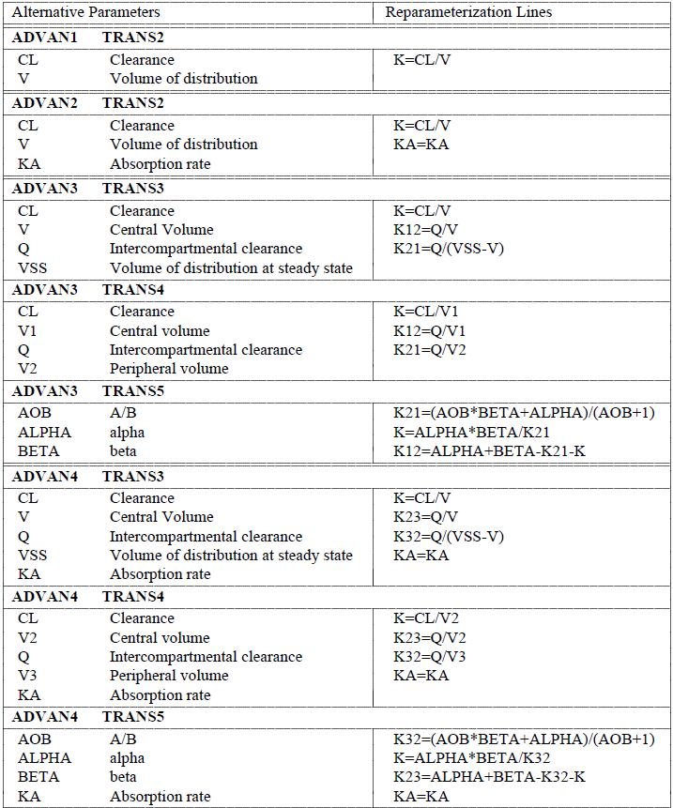
Differential Equations (2-comp PO)
2-compartment model with 1st order absorption and elimination
Depot
ka
k23
k32
k20

Slide 17

Differential Equations (2-comp PO, ADVAN5)
Depot
$SUBROUTINE ADVAN5
$PK ; Define basic PK relationships
CL = THETA(1)*EXP(ETA(1))
V2 = THETA(2)*EXP(ETA(2))
V3 = THETA(3)*EXP(ETA(3))
Q = THETA(4)*EXP(ETA(4))
KA = THETA(5)*EXP(ETA(5))
$ERROR
Y= F * (1+EPS(1))
1
ka
2
k23
3
k32
k20
$\frac{dA_{1}}{dt}$ = -A(1)*k_{a}
$\frac{dA_{2}}{dt}$ = A(1)*k_{a} - A(2)*(k₂₃+k₂₀) + A(3)*k₃₂
$\frac{dA_{3}}{dt}$ = A(2)*k₂₃ - A(3)*k₃₂

Slide 18
Differential Equations (2-comp PO, ADVAN6)
$SUBROUTINE ADVAN6 TOL=4
$PK ; Define basic PK relationships
CL = THETA(1)*EXP(ETA(1))
V2 = THETA(2)*EXP(ETA(2))
V3 = THETA(3)*EXP(ETA(3))
Q = THETA(4)*EXP(ETA(4))
KA = THETA(5)*EXP(ETA(5))
S2=V2
K20=CL/V2
K23=Q/V2
K32=Q/V3
$ERROR
Y= F * (1+EPS(1))
Depot
1
ka
2
k23
3
k32
k20
$\frac{dA_{1}}{dt}$ = -A(1)*k_{a}
$\frac{dA_{2}}{dt}$ = A(1)*k_{a} - A(2)*(k₂₃+k₂₀) + A(3)*k₃₂
$\frac{dA_{3}}{dt}$ = A(2)*k₂₃ - A(3)*k₃₂

Slide 19

Differential Equations (2-comp, IV bolus, ADVAN7)
$SUBROUTINE ADVAN7
$PK ; Define basic PK relationships
CL = THETA(1)*EXP(ETA(1))
V1 = THETA(2)*EXP(ETA(2))
V2 = THETA(3)*EXP(ETA(3))
Q = THETA(4)*EXP(ETA(4))
S1=V1
K10=CL/V1
K12=Q/V1
K21=Q/V2
$ERROR
Y= F * (1+EPS(1))
1
k12
2
k21
k10
$\frac{dA_{1}}{dt}$ = - A(1)*(k₁₂+k₁₀) + A(2)*k₂₁
$\frac{dA_{2}}{dt}$ = A(1)*k₁₂ - A(2)*k₂₁

Slide 20
Differential Equations (2-comp, IV bolus, ADVAN6)
$SUBROUTINE ADVAN6 TOL=4
$PK ; Define basic PK relationships
CL = THETA(1)*EXP(ETA(1))
V1 = THETA(2)*EXP(ETA(2))
V2 = THETA(3)*EXP(ETA(3))
Q = THETA(4)*EXP(ETA(4))
S1=V1
K10=CL/V1
K12=Q/V1
K21=Q/V2
$ERROR
Y= F * (1+EPS(1))
1
k12
2
k21
k10
$\frac{dA_{1}}{dt}$ = - A(1)*(k₁₂+k₁₀) + A(2)*k₂₁
$\frac{dA_{2}}{dt}$ = A(1)*k₁₂ - A(2)*k₂₁

Slide 21
Thank you for your attention
Coding of control stream using general ADVANs

